Slide 1

Simple Java
Chris Piech
CS106A, Stanford University

Slide 2
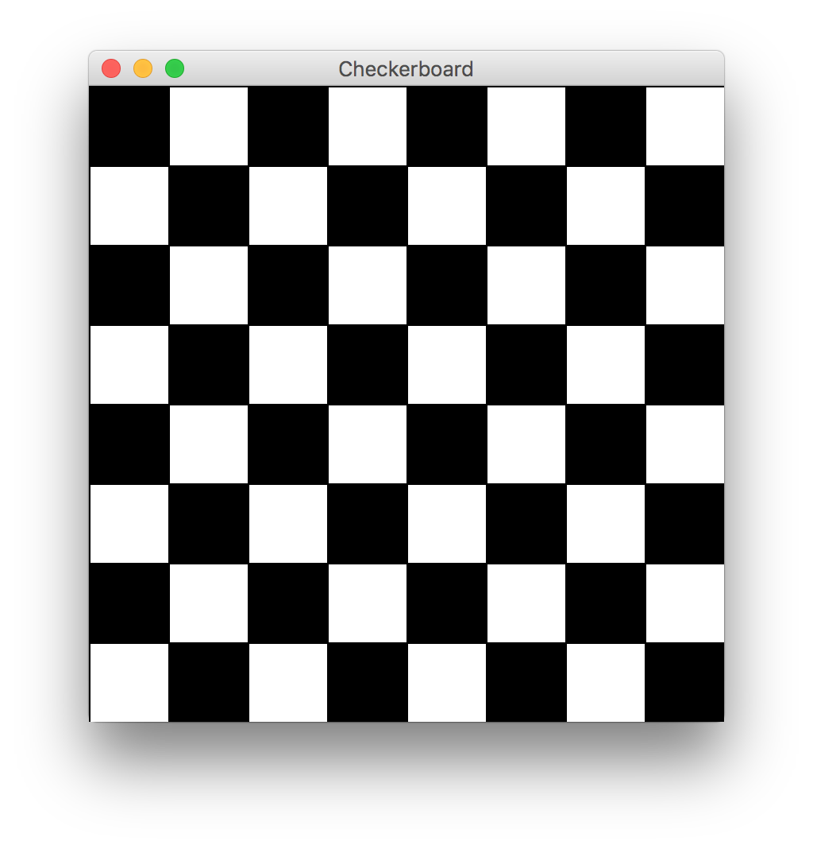

Slide 3
Let’s fix an old program

Slide 4
Review: Operations
Operations on numerical types
Operations:
+ “addition”
- “subtraction”
* “multiplication”
/ “division” (different for int vs. double)
% “remainder”
Precedence (in order):
() highest
*, /, %
+, - lowest
Operators in same precedence category evaluated left to right

Slide 5
Expressions Short Hand
int x = 3;
x = x + 1; x += 1; x++;
x = x + 5; x += 5;
x = x – 1; x -= 1; x--;
x = x * 3; x *= 3;
x = x / 2; x /= 2;

Slide 6
Review: Boolean Expressions
Boolean expression is just a test for a condition
Essentially, evaluates to true or false
Value comparisons:
== “equals” (note: not single =)
!= “not equals” (cannot say <>)
> “greater than”
< “less than”
>= “greater than or equal to”
<= “less than or equal to”

Slide 7

Today’s Goal
How to use constants
Basics of boolean variables
Understand For loops
Know variable scope

Slide 8




Today’s Route
Simple Java
For Loops
Game Show
Scope
Booleans
The River of Java

Slide 9
Boolean variable type

Slide 10
Boolean Expressions
Value comparisons (in order of precidence):
! “not”
!p
If p is true then !p is false (and vice versa)

Slide 11
Boolean Expressions
Value comparisons (in order of precidence):
! “not”
!p
&& “and”
p && q
If p is true then !p is false (and vice versa)
Evaluates to true if both sides are true

Slide 12
Boolean Expressions
Value comparisons (in order of precidence):
! “not”
!p
&& “and”
p && q
|| “or”
p || q
If p is true then !p is false (and vice versa)
Evaluates to true if both sides are true
Evaluates to true if either p or q (or both) are true

Slide 13
Boolean Expressions
Value comparisons (in order of precidence):
! “not”
!p
&& “and”
p && q
|| “or”
p || q
If p is true then !p is false (and vice versa)
Evaluates to true if both sides are true
Evaluates to true if either p or q (or both) are true
boolean p = (x != 1) || (x != 2);

Slide 14
Boolean Expressions
Value comparisons (in order of precidence):
! “not”
!p
&& “and”
p && q
|| “or”
p || q
If p is true then !p is false (and vice versa)
Evaluates to true if both sides are true
Evaluates to true if either p or q (or both) are true
boolean p = (x != 1) || (x != 2);
boolean p = (x != 1) && (X != 2);

Slide 15
*know your logical precedence

Slide 16
Today’s Route
Simple Java
For Loops
Game Show
Scope
Booleans
The River of Java

Slide 17
Today’s Route
Simple Java
For Loops
Game Show
Scope
Booleans
The River of Java

Slide 18

By Chris

Slide 19
Once upon a time…

Slide 20

X was looking for love!
int x = 5;
if(lookingForLove()) {
int y = 5;
}
println(x + y);
5
x

Slide 21
X was looking for love!
int x = 5;
if(lookingForLove()) {
int y = 5;
}
println(x + y);
5
x

Slide 22
X was looking for love!
x was definitely
looking for love
int x = 5;
if(lookingForLove()) {
int y = 5;
}
println(x + y);
5
x

Slide 23
And met y
int x = 5;
if(lookingForLove()) {
int y = 5;
}
println(x + y);
5
5
x
y

Slide 24
And met y
int x = 5;
if(lookingForLove()) {
int y = 5;
}
println(x + y);
5
5
Hi, I’m y
x
y

Slide 25
“Wow!”

Slide 26
And met y
int x = 5;
if(lookingForLove()) {
int y = 5;
}
println(x + y);
Wow
5
5
x
y

Slide 27
And met y
int x = 5;
if(lookingForLove()) {
int y = 5;
}
println(x + y);
5
5
We have so much in common
x
y

Slide 28
And met y
int x = 5;
if(lookingForLove()) {
int y = 5;
}
println(x + y);
5
5
We both have value 5!
x
y

Slide 29
And met y
int x = 5;
if(lookingForLove()) {
int y = 5;
}
println(x + y);
5
5
Maybe one day we can…
x
y

Slide 30
And met y
int x = 5;
if(lookingForLove()) {
int y = 5;
}
println(x + y);
5
5
println together?
x
y

Slide 31
They got along
int x = 5;
if(lookingForLove()) {
int y = 5;
}
println(x + y);
5
5
x
y

Slide 32
It was a beautiful match…

Slide 33
But then tragedy struck.

Slide 34
Tragedy Struck
int x = 5;
if(lookingForLove()) {
int y = 5;
}
println(x + y);
5
5
x
y

Slide 35
Tragedy Struck
int x = 5;
if(lookingForLove()) {
int y = 5;
}
println(x + y);
5
5
x
y

Slide 36

Tragedy Struck
int x = 5;
if(lookingForLove()) {
int y = 5;
}
println(x + y);
5
x

Slide 37
Noooooooooooooooo!

Slide 38
You see…

Slide 39
When a program exits a code block…
int x = 5;
if(lookingForLove()) {
int y = 5;
}
println(x + y);
5
x

Slide 40
All variables declared inside that block..
int x = 5;
if(lookingForLove()) {
int y = 5;
}
println(x + y);
5
x

Slide 41
Get deleted from memory!
int x = 5;
if(lookingForLove()) {
int y = 5;
}
println(x + y);
5
x

Slide 42
Since y was declared in the if-block
int x = 5;
if(lookingForLove()) {
int y = 5;
}
println(x + y);
5
x

Slide 43
It gets deleted from memory here
int x = 5;
if(lookingForLove()) {
int y = 5;
}
println(x + y);
5
x

Slide 44
And doesn’t exist here
int x = 5;
if(lookingForLove()) {
int y = 5;
}
println(x + y);
5
x

Slide 45
And doesn’t exist here
Error. Undefined variable y.
int x = 5;
if(lookingForLove()) {
int y = 5;
}
println(x + y);
5
x

Slide 46
The End

Slide 47
Sad times ☹

Slide 48
Variables have a lifetime (called scope)
public void run(){
double v = 8;
if(condition){
v = 4;
… some code
}
… some other code
}

Slide 49
Variables have a lifetime (called scope)
public void run(){
double v = 8;
if(condition){
v = 4;
… some code
}
… some other code
}

Slide 50
Vars come to existence when declared
public void run(){
double v = 8;
if(condition){
v = 4;
… some code
}
… some other code
}
Comes to life here
8
v

Slide 51
Live until end of their code block
public void run(){
double v = 8;
if(condition){
v = 4;
… some code
}
… some other code
}
This is the inner most
code block in which it was
declared….
4
v

Slide 52
Live until end of their code block
public void run(){
double v = 8;
if(condition){
v = 4;
… some code
}
… some other code
}
Still alive here…
4
v

Slide 53
Live until end of their code block
public void run(){
double v = 8;
if(condition){
v = 4;
… some code
}
… some other code
}
4
v
It dies here (at the end of its code block)

Slide 54

Live until end of their code block
public void run(){
double v = 8;
if(condition){
v = 4;
… some code
}
… some other code
}
It dies here (at the end of its code block)

Slide 56
Example 2
public void run(){
… some code
if(condition){
int w = 4;
… some code
}
… some other code
}
This is the scope of w

Slide 57
Example 2
public void run(){
… some code
if(condition){
int w = 4;
… some code
}
… some other code
}
w comes to life here
w dies here (at the end of its code block)

Slide 58
Chapter 2

Slide 59
The programmer fixed her bug

Slide 60
x was looking for love!
int x = 5;
if(lookingForLove()) {
int y = 5;
println(x + y);
}
5
x

Slide 61
x was looking for love…
x was definitely
looking for love
int x = 5;
if(lookingForLove()) {
int y = 5;
println(x + y);
}
5
x

Slide 62
x met y
int x = 5;
if(lookingForLove()) {
int y = 5;
println(x + y);
}
5
5
x
y

Slide 63
Since they were both “in scope”
int x = 5;
if(lookingForLove()) {
int y = 5;
println(x + y);
}
5
5
x
y

Slide 64
The story had a happy ending!

Slide 65
Scope Formally
The scope of a variable refers to the section of code where a variable can be accessed.
Scope starts where the variable is declared.
Scope ends at the termination of the inner-most code block in which the variable was defined.
A code block is a chunk of code between { } brackets

Slide 66
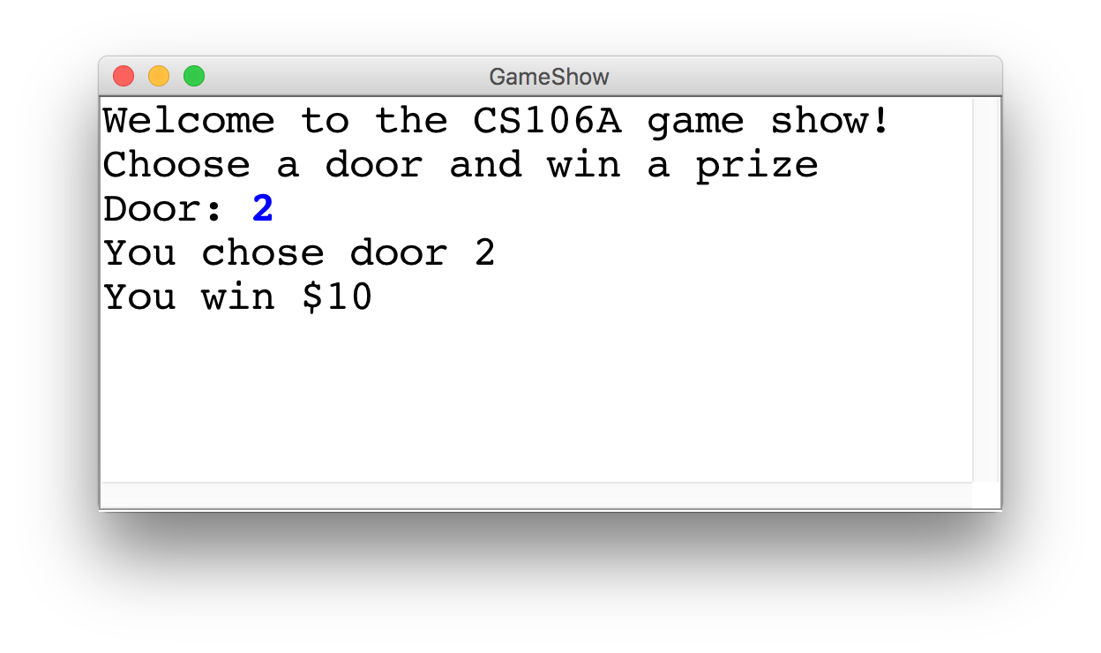
Game Show

Slide 67
Choose a Door
int door = readInt("Door: ");
// while the input is invalid
while(door < 1 || door > 3) {
// tell the user the input was invalid
println("Invalid door!");
// ask for a new input
door = readInt("Door: ");
}
|| or
&& and

Slide 68
The Door Logic
int prize = 4;
if(door == 1) {
prize = 2 + 9 / 10 * 100;
} else if(door == 2) {
boolean locked = prize % 2 != 0;
if(!locked) {
prize += 6;
}
} else if(door == 3) {
prize++;
}

Slide 69
The Door Logic
int prize = 4;
if(door == 1) {
prize = 2 + 9 / 10 * 100;
} else if(door == 2) {
boolean locked = prize % 2 != 0;
if(!locked) {
prize += 6;
}
} else if(door == 3) {
prize++;
}

Slide 70
The Door Logic
int prize = 4;
if(door == 1) {
prize = 2 + 9 / 10 * 100;
} else if(door == 2) {
boolean locked = prize % 2 != 0;
if(!locked) {
prize += 6;
}
} else if(door == 3) {
prize++;
}

Slide 71
The Door Logic
int prize = 4;
if(door == 1) {
prize = 2 + 9 / 10 * 100;
} else if(door == 2) {
boolean locked = prize % 2 != 0;
if(!locked) {
prize += 6;
}
} else if(door == 3) {
prize++;
}

Slide 72
The Door Logic
int prize = 4;
if(door == 1) {
prize = 2 + 9 / 10 * 100;
} else if(door == 2) {
boolean locked = prize % 2 != 0;
if(!locked) {
prize += 6;
}
} else if(door == 3) {
prize++;
}

Slide 73
Today’s Route
Simple Java
For Loops
Game Show
Scope
Booleans
The River of Java

Slide 74
Today’s Route
Simple Java
For Loops
Game Show
Scope
Booleans
The River of Java

Slide 75
How would you println “Nick rocks socks”
100 times

Slide 76
println(“Nick rocks socks!”);
println(“Nick rocks socks!”);
println(“Nick rocks socks!”);
println(“Nick rocks socks!”);
println(“Nick rocks socks!”);
println(“Nick rocks socks!”);
println(“Nick rocks socks!”);
println(“Nick rocks socks!”);
println(“Nick rocks socks!”);
println(“Nick rocks socks!”);
println(“Nick rocks socks!”);
println(“Nick rocks socks!”);
println(“Nick rocks socks!”);
println(“Nick rocks socks!”);
println(“Nick rocks socks!”);
println(“Nick rocks socks!”);
println(“Nick rocks socks!”);
println(“Nick rocks socks!”);

Slide 77
For Loop Redux
public void run() {
for(int i = 0; i < 100; i++) {
println(“Nick rocks socks!”);
}
}

Slide 78
For Loop Redux
Enters the loop if this condition passes
This line is run each time the code gets to the end of the ‘body’
This line is run once, just before the for loop starts
for(int i = 0; i < 100; i++) {
println(“Nick rocks socks!”);
}

Slide 79

For Loop Redux
for(int i = 0; i < 3; i++) {
println(“Nick rocks socks!”);
}
For Loop Redux

Slide 80
For Loop Redux
for(int i = 0; i < 3; i++) {
println(“Nick rocks socks!”);
}
For Loop Redux

Slide 81
For Loop Redux
i
0
for(int i = 0; i < 3; i++) {
println(“Nick rocks socks!”);
}
For Loop Redux

Slide 82
For Loop Redux
i
0
for(int i = 0; i < 3; i++) {
println(“Nick rocks socks!”);
}
For Loop Redux

Slide 83
For Loop Redux
i
0
for(int i = 0; i < 3; i++) {
println(“Nick rocks socks!”);
}
For Loop Redux
Nick rocks socks

Slide 84
For Loop Redux
i
0
for(int i = 0; i < 3; i++) {
println(“Nick rocks socks!”);
}
For Loop Redux
Nick rocks socks

Slide 85
For Loop Redux
i
1
for(int i = 0; i < 3; i++) {
println(“Nick rocks socks!”);
}
For Loop Redux
Nick rocks socks

Slide 86
For Loop Redux
i
1
for(int i = 0; i < 3; i++) {
println(“Nick rocks socks!”);
}
For Loop Redux
Nick rocks socks

Slide 87
For Loop Redux
i
1
for(int i = 0; i < 3; i++) {
println(“Nick rocks socks!”);
}
For Loop Redux
Nick rocks socks
Nick rocks socks

Slide 88
For Loop Redux
i
2
for(int i = 0; i < 3; i++) {
println(“Nick rocks socks!”);
}
For Loop Redux
Nick rocks socks
Nick rocks socks

Slide 89
For Loop Redux
i
2
for(int i = 0; i < 3; i++) {
println(“Nick rocks socks!”);
}
For Loop Redux
Nick rocks socks
Nick rocks socks

Slide 90
For Loop Redux
i
2
for(int i = 0; i < 3; i++) {
println(“Nick rocks socks!”);
}
For Loop Redux
Nick rocks socks
Nick rocks socks
Nick rocks socks

Slide 91
For Loop Redux
i
3
for(int i = 0; i < 3; i++) {
println(“Nick rocks socks!”);
}
For Loop Redux
Nick rocks socks
Nick rocks socks
Nick rocks socks

Slide 92
For Loop Redux
i
3
for(int i = 0; i < 3; i++) {
println(“Nick rocks socks!”);
}
For Loop Redux
Nick rocks socks
Nick rocks socks
Nick rocks socks

Slide 93
For Loop Redux
for(int i = 0; i < 3; i++) {
println(“Nick rocks socks!”);
}
For Loop Redux
Nick rocks socks
Nick rocks socks
Nick rocks socks

Slide 94
For Loop Redux
for(int i = 0; i < 3; i++) {
println(“Nick rocks socks!”);
}
For Loop Redux
Nick rocks socks
Nick rocks socks
Nick rocks socks

Slide 95
You can use the for loop variable

Slide 96
How would you println the first 100 even numbers?

Slide 97
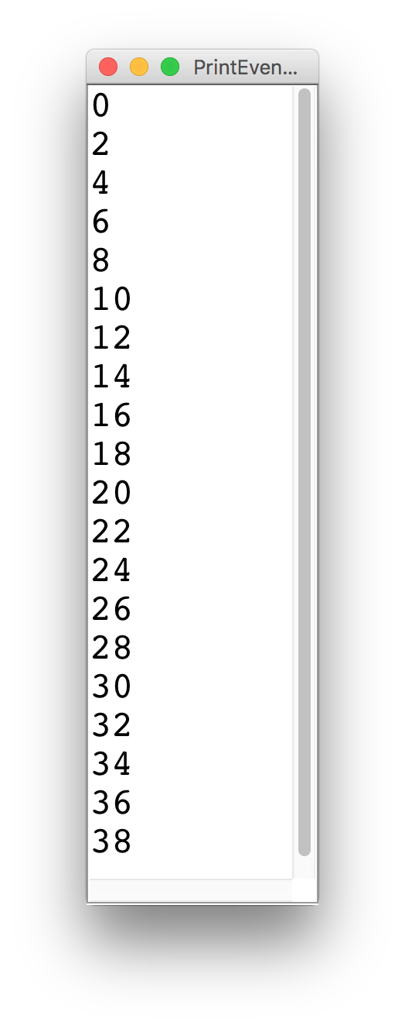
Printing Even Numbers

Slide 98
Printing Even Numbers
for(int i = 0; i < NUM_NUMS; i++) {
println(i * 2);
}

Slide 99
Printing Even Numbers
for(int i = 0; i < 3; i++) {
println(i * 2);
}
For Loop Redux

Slide 100
Printing Even Numbers
for(int i = 0; i < 3; i++) {
println(i * 2);
}
For Loop Redux

Slide 101
Printing Even Numbers
i
0
for(int i = 0; i < 3; i++) {
println(i * 2);
}
For Loop Redux

Slide 102
Printing Even Numbers
i
0
for(int i = 0; i < 3; i++) {
println(i * 2);
}
For Loop Redux

Slide 103
Printing Even Numbers
i
0
for(int i = 0; i < 3; i++) {
println(i * 2);
}
For Loop Redux
0

Slide 104
Printing Even Numbers
i
1
for(int i = 0; i < 3; i++) {
println(i * 2);
}
For Loop Redux
0

Slide 105
Printing Even Numbers
i
1
for(int i = 0; i < 3; i++) {
println(i * 2);
}
For Loop Redux
0

Slide 106
Printing Even Numbers
i
1
for(int i = 0; i < 3; i++) {
println(i * 2);
}
For Loop Redux
0
2

Slide 107
Printing Even Numbers
i
2
for(int i = 0; i < 3; i++) {
println(i * 2);
}
For Loop Redux
0
2

Slide 108
Printing Even Numbers
i
2
for(int i = 0; i < 3; i++) {
println(i * 2);
}
For Loop Redux
0
2

Slide 109
Printing Even Numbers
i
2
for(int i = 0; i < 3; i++) {
println(i * 2);
}
For Loop Redux
0
2
4

Slide 110
Printing Even Numbers
i
3
for(int i = 0; i < 3; i++) {
println(i * 2);
}
For Loop Redux
0
2
4

Slide 111
Printing Even Numbers
i
3
for(int i = 0; i < 3; i++) {
println(i * 2);
}
For Loop Redux
0
2
4

Slide 112
Printing Even Numbers
i
3
for(int i = 0; i < 3; i++) {
println(i * 2);
}
For Loop Redux
0
2
4

Slide 113
Printing Even Numbers
for(int i = 0; i < 3; i++) {
println(i * 2);
}
For Loop Redux
0
2
4

Slide 114
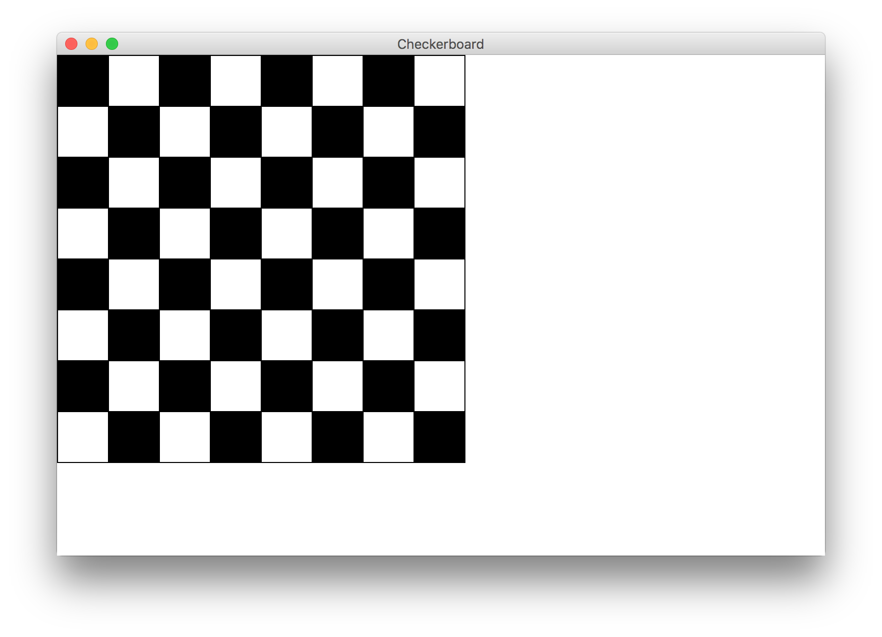

Slide 115
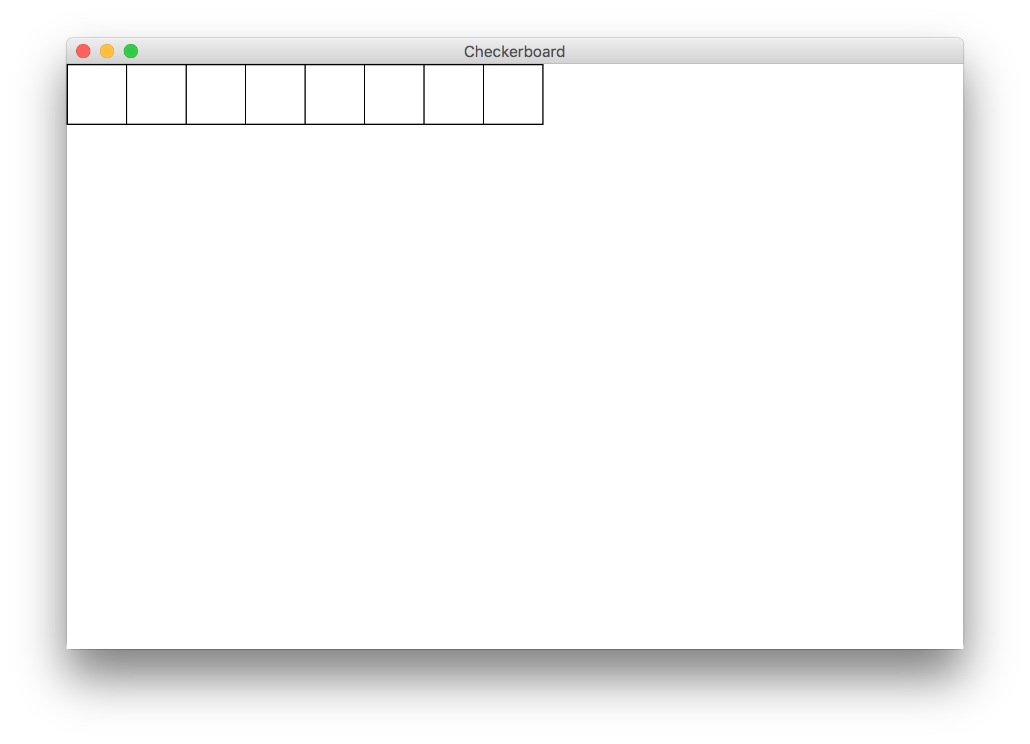
Milestone 1

Slide 116
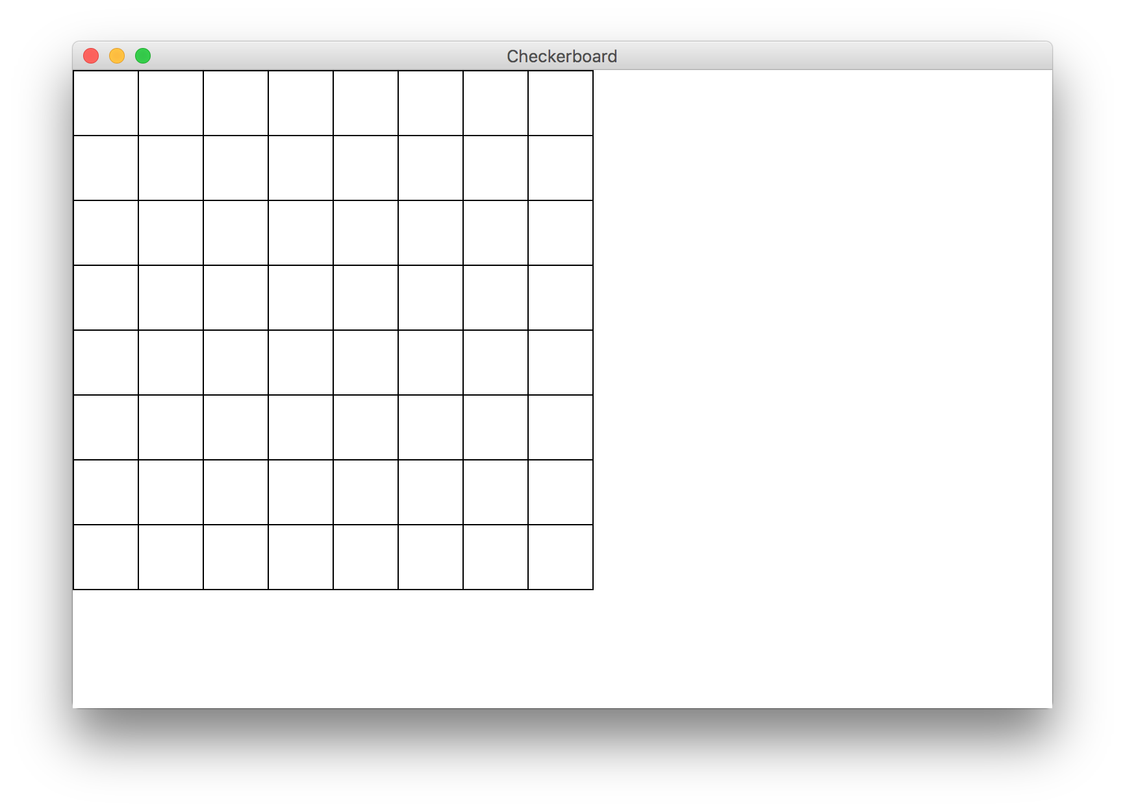
Milestone 2

Slide 117
Milestone 3

Slide 118
Today’s Route
You are here
Simple Java
For Loops
Conditions
Graphics
Review
The River of Java

Slide 119
Today’s Route
You are here
Simple Java
For Loops
Conditions
Graphics
Review
The River of Java

Slide 120
Today’s Goal
How to use constants
Basics of boolean variables
Understand For loops
Know variable scope

